Slide 1
Data Curation Project -
Airplane Accidents, Failures & Hijacks
M. Chalke, F. Escudero, N. Lyubenko

Slide 2

DATASETS
Aircraft Accidents, Failures & Hijacks Dataset
A dataset of Aircraft Accidents, Failures & Hijacks since 1919
23519 Records | 23 Columns (8.9MB)
Airplane Crashes Since 1908
Full history of airplane crashes throughout the world from 1908
5268 Records | 13 Columns (1.52MB)
Notes:
Maitreyi

Slide 3

IDENTIFIED ISSUES
Redundant Columns
Duplicate Rows
Missing | Null Values
Inconsistent Values
Unnormalized Data
Notes:
Maitreyi

Slide 4

DATASET CLEANING SOLUTIONS
Renamed Attributes
Redundant Rows
Redundant Columns (DateTime / Fatalities)
Derived Aircraft Age from First Flight
Separated columns for fatalities and occupants
Normalized Dates
Notes:
Maitreyi

Slide 5
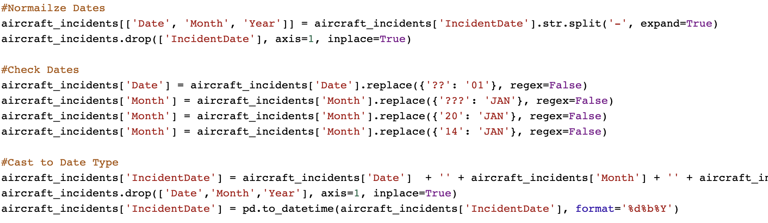
DATASET CLEANING SOLUTIONS
Example 1: Normalizing Dates
Solution:
Notes:
Nic

Slide 6
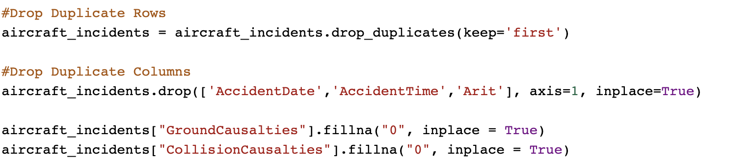
DATASET CLEANING SOLUTIONS
Example 2: Removing duplicate rows and columns
Solution:
Notes:
Nic

Slide 7
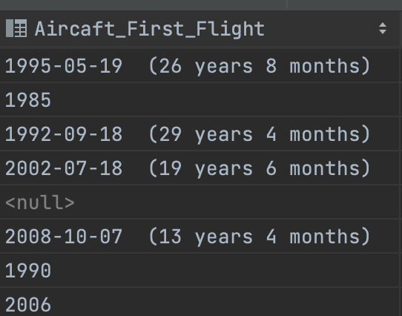
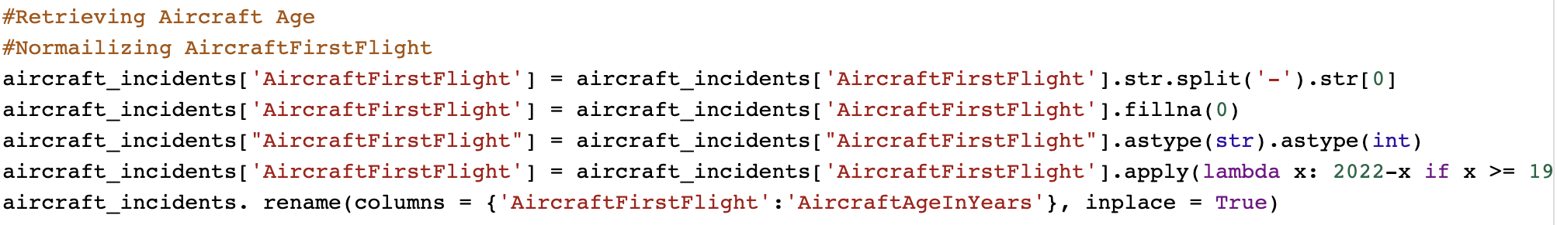
DATASET CLEANING SOLUTIONS
Example 3: Deriving Aircraft Age from Aircraft First Flight
Solution:
Notes:
Nic

Slide 8
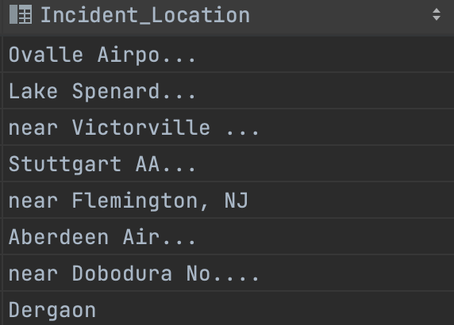
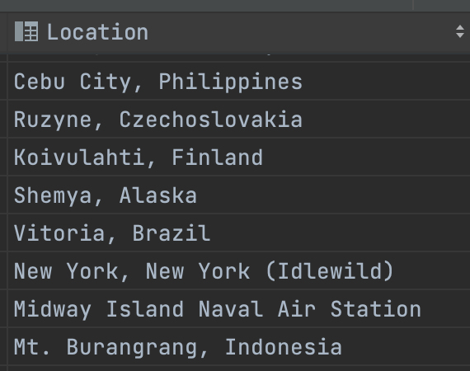
DATASET CLEANING SOLUTIONS
Example 4: Correcting Incident Locations
Solution:
Old format
New format
Notes:
Nic

Slide 9
DATASET CLEANING SOLUTIONS
Other Work:
Normalized Null/Unknown values
Normalized Aircraft Nature
Normalized Aircraft Model
Normalized Aircraft Registration
Normalize or combine columns for incident causes
Replaced Departure Airport Names and Destination Airport Names with Airport Code
Notes:
Quico

Slide 10

CHALLENGES
Calculating only code from Departure Airport and Destination airport
Merging the elements of the second dataset to fill in missing information:
Different sources
Fewer rows than first dataset
Casting values to be same datatype of merge
Figuring out how to fill the null values without information
Notes:
Quico

Slide 11

FUTURE SCOPE
Create New Tables For
Crash Summaries
Incident Causes and Aircraft Damage
Missing (NULL) values:
Incident Location - 929 rows
Military (Non disclosed / Others / Unknown)
Aircraft Engines - 12883 rows
Departure Airport - 10347 rows
Destination airport - 10290 rows
Notes:
Quico

Slide 12

CONCLUSION
Normalized records using a secondary dataset
Discarded redundant records and attributes
Information from two different sources may be not very useful
Formats may vary among columns, even among rows
Notes:
Quico

Slide 13
REFERENCES
Main dataset: https://www.kaggle.com/datasets/deepcontractor/aircraft-accidents-failures-hijacks-dataset
Second dataset: https://www.kaggle.com/datasets/saurograndi/airplane-crashes-since-1908
Foto de Cameron Casey en Pexels
Foto de Vishal Shah en Pexels
Foto de Tom Swinnen en Pexels
Foto de Anete Lusina en Pexels
Foto de Olya Kobruseva en Pexels
Foto de Karolina Grabowska en Pexels
Foto de Roberto Nickson en Pexels
Foto de Inge Wallumrød en Pexels

Slide 14
Thank You
Questions?

